Slide 1
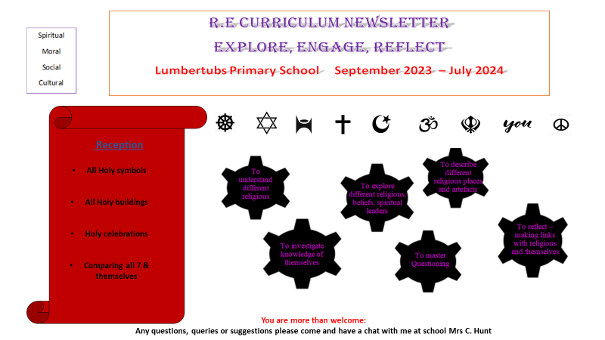


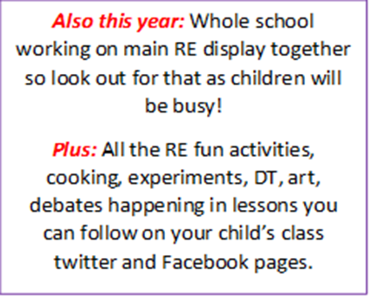

Slide 2
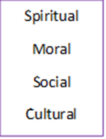


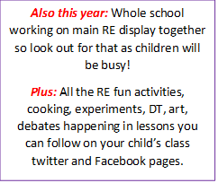
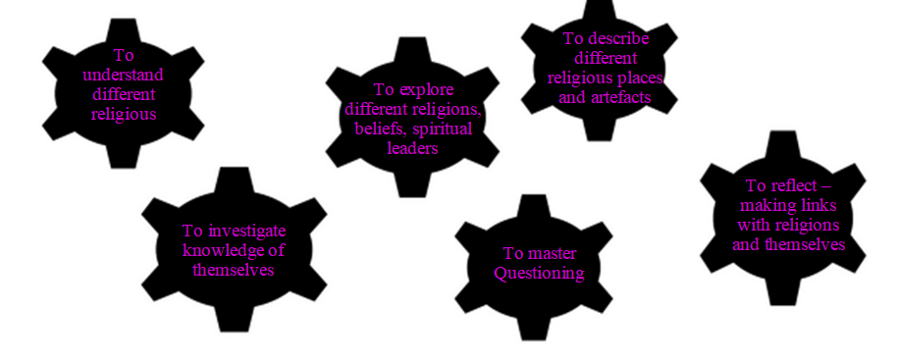

R.E curriculum newsletter
Religions, Worldviews, non- religious
Lumbertubs Primary School September 2025 – July 2026
* Chinese New Year
You are more than welcome:
Any questions, queries or suggestions please come and have a chat with me at school Mrs C. Hunt.

Slide 3

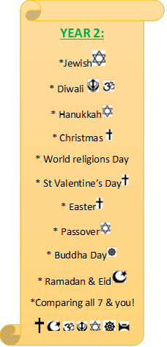


* Chinese New Year

Slide 4






* Chinese New Year

Slide 5
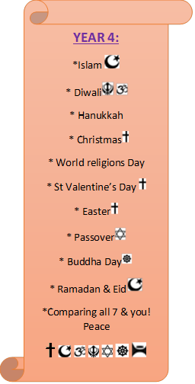
* Chinese New Year

Slide 6

* Chinese New Year

Slide 7

* Chinese New Year

