Slide 1
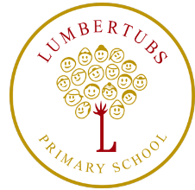
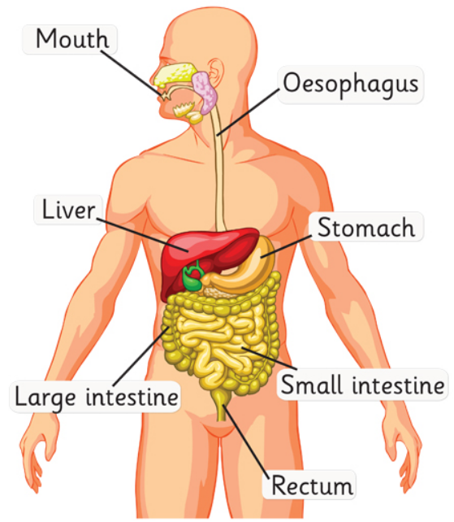
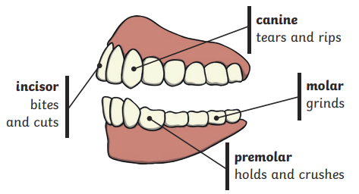
Burps, Bottoms and Bile
Y4 Science
Key vocabulary:
The digestive system
Digest | Break down food so it can be used for the body
Mouth | The opening to the digestive system where food is chewed and mixed with saliva
Oesophagus | A muscular tube which moves food from the mouth to the stomach
Stomach | An organ in the digestion system where food is broken down with stomach acid and mixed.
Small intestine | Part of the intestine where nutrients are absorbed into the body
Large intestine | Part of the intestine where water is absorbed from remaining waste food. Faeces/poo is formed here.
Rectum | Where faeces (poo) is stored before leaving the body.
Saliva | Clear liquid in the mouth that’s made of water and chemicals that begin to break down food
Human teeth and their functions

