Slide 1

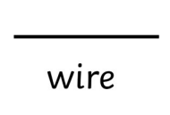
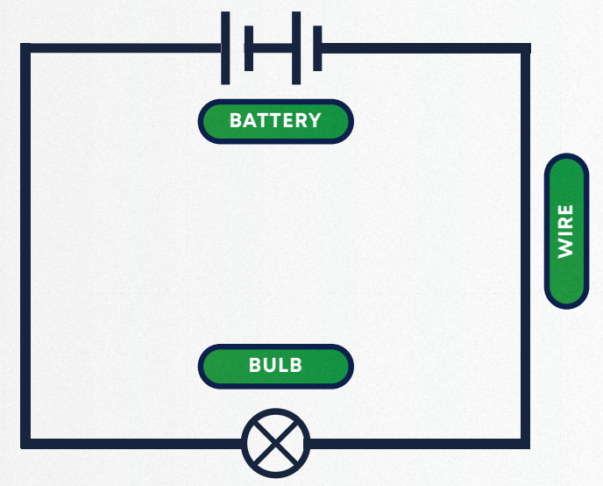
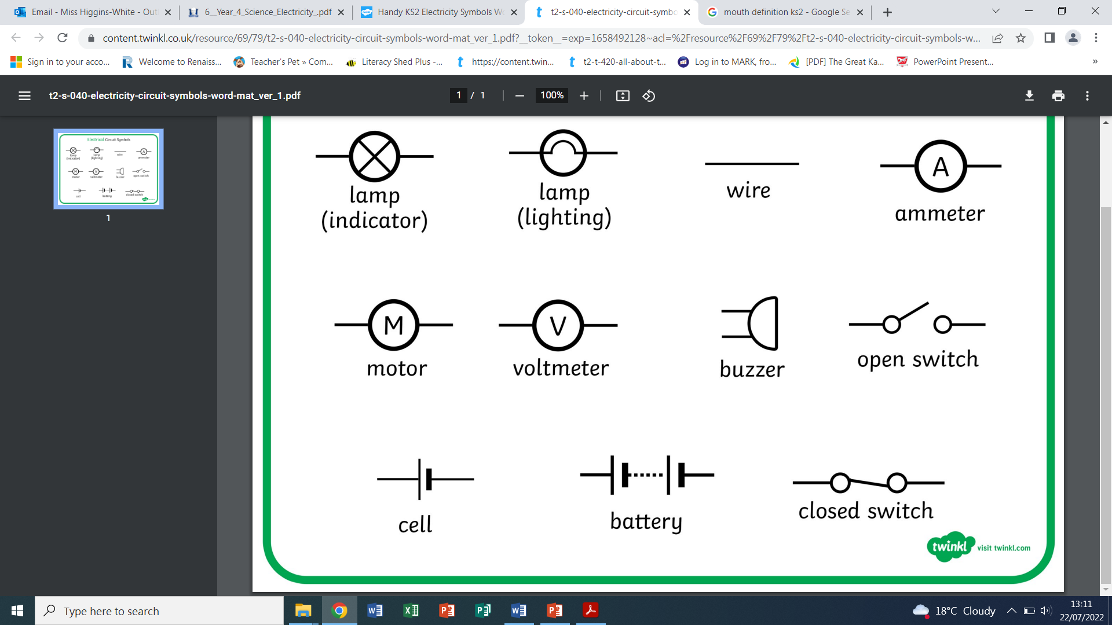


Danger! Danger!
Y4 Science
Key vocabulary:
Circuit symbols
Electricity | The flow of an electric current through a material.
Circuit | A pathway that electricity can flow around which includes a wire and a power supply.
Electrical current | Flow of electricity around a circuit
Battery | Store of electrical energy
Light bulb | An electrical component that converts electrical energy to light energy
Switch | An electrical component that can open and close an electrical circuit
Wire | A thin piece of metal (usually covered in plastic) that allows electricity to flow through it
Conductor | An electrical conductor that allows electricity to flow through it
Insulator | An electrical insulator that does not allow electricity to flow through it
Appliances | A piece of equipment or device that performs a particular job
A simple circuit

