Slide 1
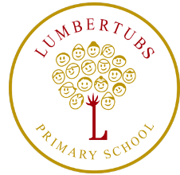
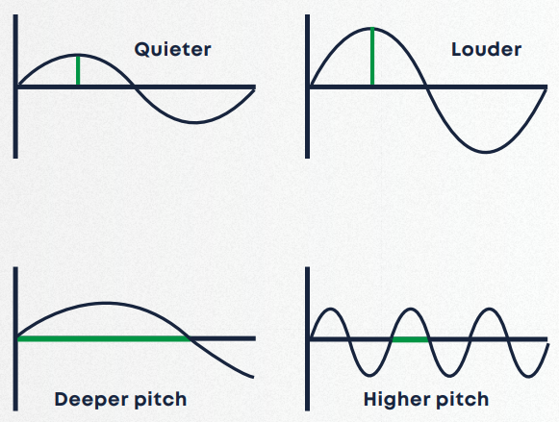
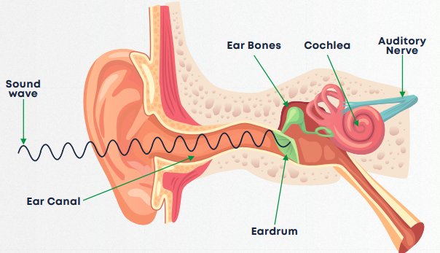
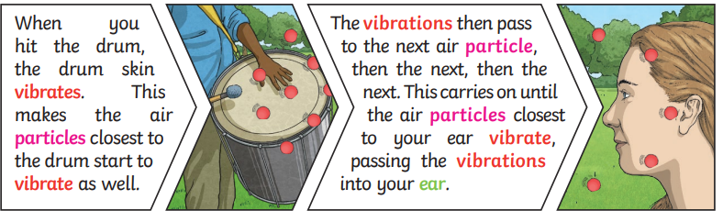
Sound
Y4 Science
Key vocabulary:
Sound waves
The Ear
Sound | A type of energy created by vibrations.
Vibration | A back-and-forth movement. They are essential for us to hear sound.
Sound Waves | A wave of vibrations that move through the air when a sound is made, carrying the sound to our ears.
Pitch | How high or low a sound is
Volume | How loud or quiet a sound is
Decibel | A measure of how loud a sound is
Amplitude | The size of a vibration A large amplitude = a loud sound
Sound medium | A substance in which sound waves travel. This includes the air, water, wood.
Ear | An organ used for hearing

