Slide 1
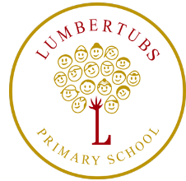
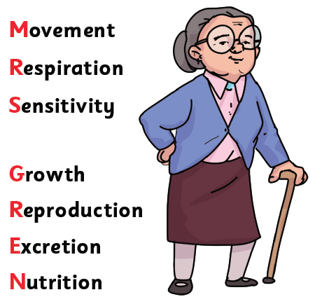
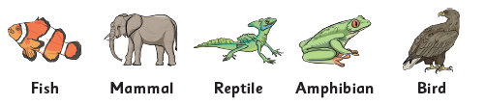
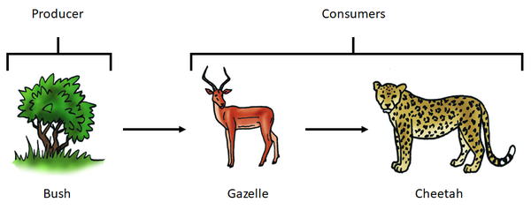
Living Earth
Y4 Science
Key vocabulary:
Classification | Grouping and ordering things based on their features.
Vertebrate | An animal with a backbone
Invertebrate | An animal without a backbone
Habitat | The specific area or place in which particular animals or plants live
Producer | An organism, such as a plant, that produces its own food.
Predator | An animal that hunts and eats other animals.
Prey | An animal that gets hunted and eaten by another animal.
Food chain | The order in which living things depend on each other for food.
Herbivore | An animal that eats plants
Carnivore | An animal that eats other animals.
Omnivore | An animal that eats plants and animals.
Food Chains

