Slide 1

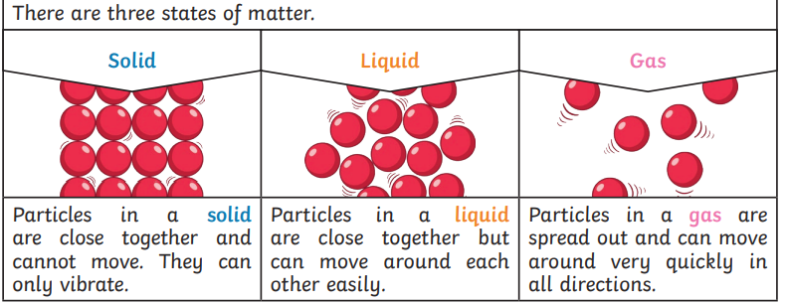
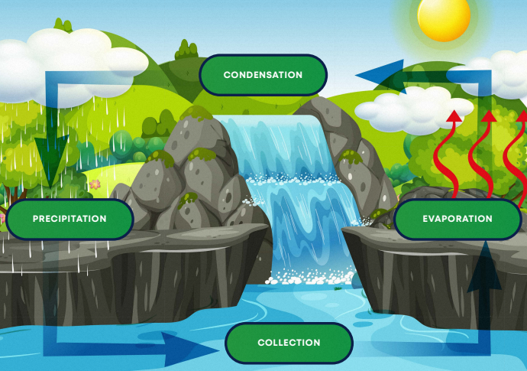
States of Matter
Y4 Science
Key vocabulary:
Solid | A state of matter that keeps it shape unless force is applied
Liquid | A state of matter that takes the shape of the container that holds them. They can be poured.
Gas | A state of matter that has no fixed shape and expand to fill the container they are in.
Water vapour | When water turns into gas
Melt | When a solid changes to a liquid
Freeze | When liquid turns into a solid
Evaporation | When a liquid turns into a gas
Condensation | When a gas turns into a liquid
Precipitation | The process where water moves from the clouds to the Earth’s surface. It can be rain, snow, sleet or hail.
Cycle | A series of events that repeats in the same order.
The Water Cycle

